Slide 1
Master thesis presentation
Thomas sadurni

Slide 2
Research question
Price movement prediction of cryptocurrencies using investor’s sentiment and machine learning.
Forecasting price movement of cryptocurrencies using investor’s sentiment and machine learning.
How Investors’ fear and uncertainty can be used to predict the future short-term movement of cryptocurrencies prices? Using sentiment and machine learning

Slide 3
Themes
Cryptocurrencies
Machine learning
Behavioural Finance
Trading
Sentiment
Index

Slide 4



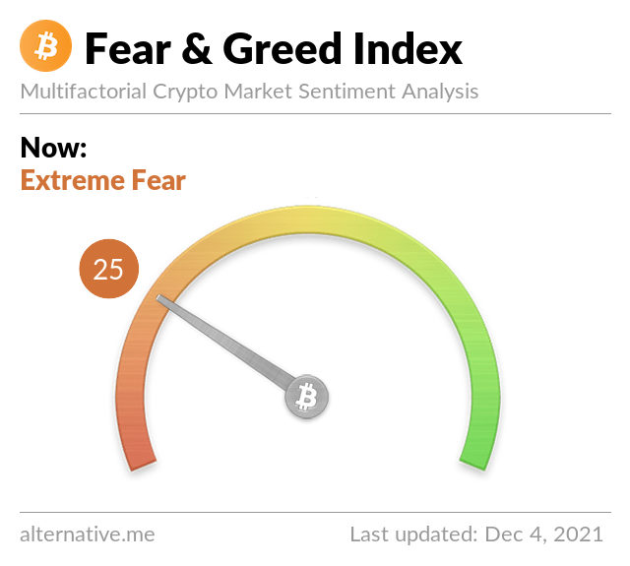
Data
Finance
Crypto Prices
Players predictions
CryptoPick data : players bet on the movement of cryptocurrencies for the next day
API
Crypto Fear and Greed (sentiment of investors)
CoinMarketCap or Binance
Crowd opinion
Best players opinion
Twitter / StockTwist
Crypto Fear and Greed
VIX, AAII, SENTIX & other sentiment index
Crypto Index
Yahoo Finance

Slide 5


Methodology
Quantitative analysis
OLS/GLS/VAR Regressions
$p_{t}=α+βp_{t−1}+ γ{CFG}_{t−1}+ μ{VIX}_{t−1}+θ{S\&P}_{t−1}+ρ{Bulls}_{t−1}+τ$….
Correlations
Charts
Predictive Algorithms (machine learning with LSTM) with price and sentiment as inputs in Python

Slide 6
Contribution
Data :
None of the Financial articles use the data of CryptoPick
None of the Financial articles use the API of Crypto Fear and Greed
None use all crypto assets, only 10, maximum 15 crypto where used and not all -> Crypto total index
Work :
Try to find a correlation between the Price Action and the sentiment of the crowd/expert of CryptoPick
Create an Index with players prediction and Crypto Fear & Greed
See the impact of sentiment index of equity market (VIX, US Equity Uncertainty index, American Association Individual Investors) on the crypto market and see the possibility of hedging, like gold
Regression using different factors: CFG, CryptoPick, VIX, SENTIX
Effect pre-covid, post-covid and see the difference + overall analysis
Using machine learning (LSTM or other) and the previous work to try to predict

Slide 7
Literature reviews
Ranking : CNRS
Investor Sentiment and the Cross-Section of Stock Returns, Journal of Finance, 1 (when sentiment is low, the subsequent returns on stocks at both extreme are especially high relative to their unconditional average, while stocks in the middle deciles are less affected by sentiment)
Giving Content to Investor Sentiment: The Role of Media in the Stock Market, Journal of Finance, 1 (stocks of low capitalization, younger, unprofitable, high-volatility, non–dividend paying, growth companies or stocks of firms in financial distress are likely to be disproportionately sensitive to broad waves of investor sentiment)
Is Bitcoin Really Untethered ? Journal of Finance, 1 (BTC Price is manipulated by one address)
Investor Sentiment in the Stock Market, Journal of Economic Perspectives, 1
Analysis of Bitcoin prices using market and sentiment variables, World Economy, 2 (The S&P 500 index has a positive effect on the fundamental value of Bitcoin prices and the gold spot price and the fear index have a negative effect.)
The predictive power of public Twitter sentiment for forecasting cryptocurrency prices, Journal of Inter. Financial Markets, Institutions & Money, 3 (Twitter sentiment can be used to predict the price returns of Bitcoin, Bitcoin Cash and Litecoin)
On cryptocurrencies as an independent asset class: Long-horizon and COVID-19 pandemic era decoupling from global sentiments, Finance Research letters, 3 (Crypto as decoupled asset class)
Does Sentiment Impact Cryptocurrency?, Journal of Behavioural Finance, NR (When the investor sentiment is exceptionally pessimistic or optimistic, there is a possibility of extreme movement in the prices)
And others …

